Slide 1
Introduction to Data Science/ Data Mining for Business Analytics
Brian d’Alessandro
Adjunct Professor, NYU
Fall 2015
Fine Print: these slides are, and always will be a work in progress. The material presented herein is original, inspired, or borrowed from others’ work. Where possible, attribution and acknowledgement will be made to content’s original source. Do not distribute, except for as needed as a pedagogical tool in the subject of Data Science.
Notes:
https://www.youtube.com/watch?v=aMDe5pODkB0 (harlan harris)

Slide 2
this course’s #1 goal is to help you to BecomE a data scientist

Slide 3

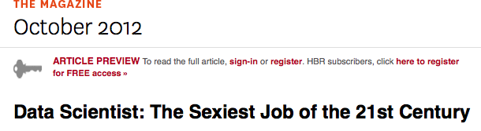
Too sexy for this course?
“Data scientists are the key to realizing the opportunities presented by big data. They bring structure to it, find compelling patterns in it, and advise executives on the implications for products, processes, and decisions.
They find the story buried in the data and communicate it. And they don’t just deliver reports:
They get at the questions at the heart of problems and devise creative approaches to them.”
http://hbr.org/2012/10/data-scientist-the-sexiest-job-of-the-21st-century/
Notes:
Put photo of books

Slide 4
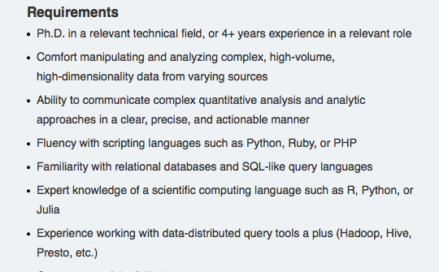
The resume: skills
Through the lens of a Data Scientist Job Description
PhD is a proxy for:
experience
research ability
technical expertise
Notes:
Show photos of stats and pandas

Slide 5
The resume: skills
Through the lens of a Data Scientist Job Description
You can’t be a Data Scientist if you can’t handle data…
Notes:
Show photos of stats and pandas

Slide 6
The resume: skills
Through the lens of a Data Scientist Job Description
This is essentially the goal of this course.
Notes:
Show photos of stats and pandas

Slide 7
The hard skills
Through the lens of a Data Scientist Job Description
Necessary: a scripting language, SQL and a scientific computing language. You will get hands-on experience with some of this in this course, and you should definitely develop these skills throughout this program.
Notes:
Show photos of stats and pandas

Slide 8
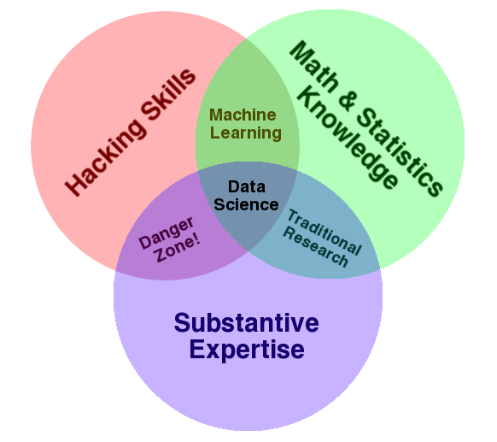
this is a popular diagram
What skills do we expect in our data scientists?
Source: http://drewconway.com/zia/2013/3/26/the-data-science-venn-diagram
Notes:
Why is the “danger zone” dangerous? Knowing how to build a model, but not knowing what a model is.

Slide 9
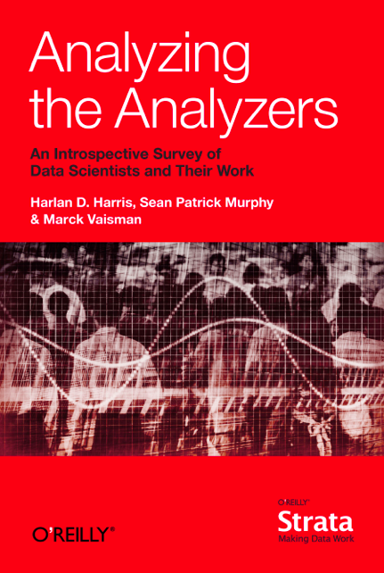
Towards a definition
There is no
‘one-size-fits-all’ type of
data scientist.
Luckily, people are
using data science to define data science.
Notes:
Put photo of books

Slide 10
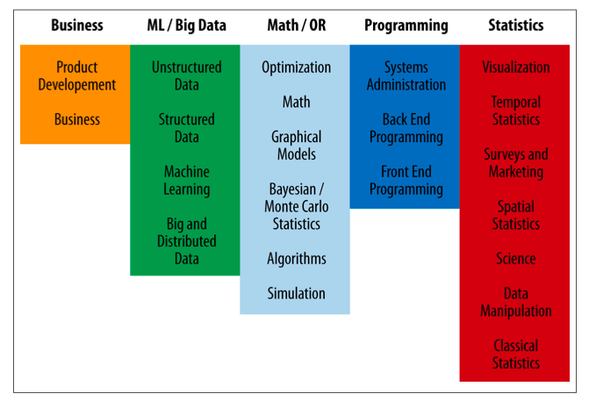
Range of ds skills
They’re all very similar, but some categorization still helps.
Notes:
Put photo of books

Slide 11
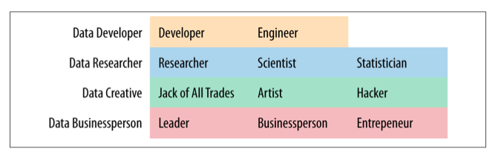
Data roles
In Analyzing the Analyzers, the authors identified 4 types of “data scientists.”
Notes:
Put photo of books

Slide 12
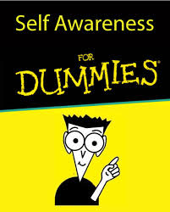
It matters
You don’t have to fit into one bucket, but you should know where you are…
Personal skills development
Choosing the right job (your future boss might not know what a data scientist is, or should be)
DATA SCIENTISTS
Notes:
Put photo of books

Slide 13

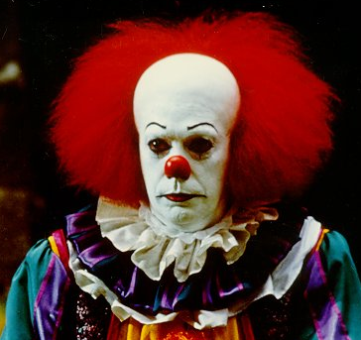
Data science profile
What I think I am…
Notes:
Show my DS profile

Slide 14
Why science?
We defined 4 data roles, but what is the “science” of data science?
The scientific method: evaluating the merit of a hypothesis with rigorous empirical testing.
I.e.,
Given raw data, constraints and a problem statement, you have an infinite set of models to choose from, with which you will use to maximize performance on some evaluation metric, that you will have to specify.
Every design choice you make can be formulated as a hypothesis, upon which you will use rigorous testing and experimentation to either validate or refute.
Notes:
Show my DS profile

Slide 15
but its still an art
Outside of modeling competitions, seldom is a well-posed problem and clean dataset presented to you.
Putting the art into your practice means…
Translating problems into the language of data science
Formulating reasonable hypotheses
Developing an intuition for good vs. bad data, good vs. bad models.
Abstracting problems to identify similarities
Managing the DS process from end to end
Notes:
Show my DS profile

Slide 16
reminder
With this course we want to emphasize the soft skills of data science
Art => Abstract and intuitive thinking
Science => process
We’ll cover necessary DS tools, but with the goal of applying them towards analytic problem solving.
Notes:
Show my DS profile

